Slide 1
Encryption
Written by : Aqsa Farooq

Slide 2
Encryption
Definition
Encryption is the process of converting readable information into a secret/unreadable form and safely turning it back again so that unauthorized people cannot understand it.
Example:
You send your friend
“Hello”
Encryption changes it into something like
“X7@kP9#”
Your friend’s device uses a key to decrypt it and convert it back to:
“Hello”

Slide 3
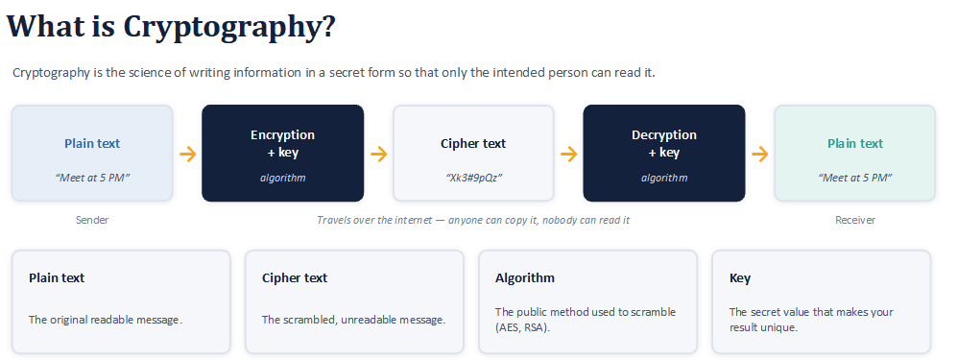

Slide 4
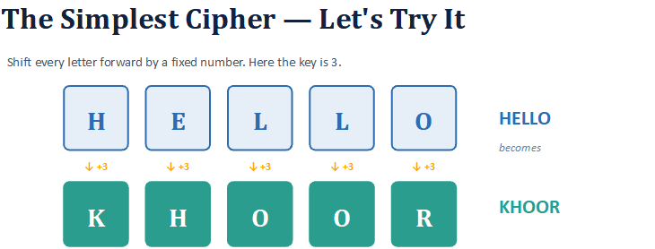
OKARA → ?
SECURE → ?
(Answer: RNDUD and VHFXUH)

Slide 5
Types of encryption
Symmetric encryption
(same key = Private key)
ASymmetric encryption
(Different key = Public key+Private key)

Slide 6
Symmetric encryption
(Same key for encrption and decryption)
Definition:
Symmetric encryption is an encryption method where the same key is used to encrypt (lock) and decrypt(unlock) the information.
Example:
Like a box that is locked and unlocked using the same key.
It can encrypt and decrypt large amounts of data quickly.
Good for protecting large amounts of data.
Requires relatively less computing power than asymmetric encryption.
Symmetric encryption Algorithms
1. AES :Advanced Encryption Standard
2. DES : Data Encryption Standard
3. 3DES :Triple Data Encryption Standard

Slide 7
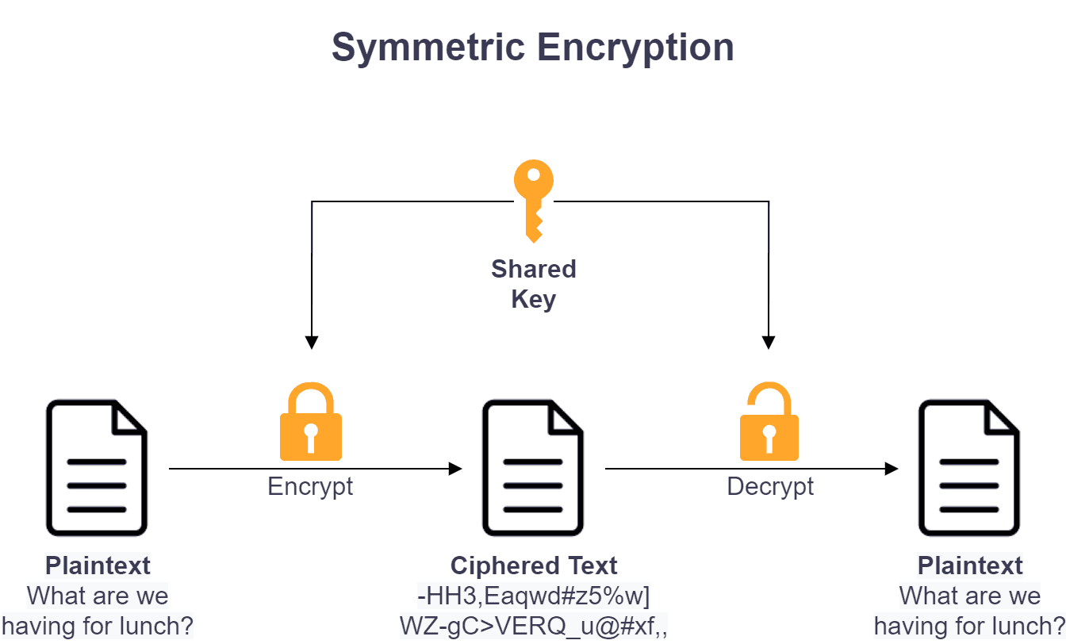

Slide 8
ASymmetric encryption
(Same key for encrption and decryption)
Definition:
Asymmetric encryption is a method where two different keys are used: a public key and a private key.
Example:
Think of a mailbox: anyone can put a letter inside (public key), but only the owner has the key to open it (private key).
1. Public Key :can be shared with everyone.
2. Private Key : kept secret by the owner.
It is especially useful when two people or systems need secure communication without already sharing a secret key.
Asymmetric encryption is generally slower than symmetric encryption, especially for encrypting large amounts of data. Therefore, real systems often use asymmetric cryptography to establish or protect a symmetric session key, and then use symmetric encryption for the actual bulk data.

Slide 9
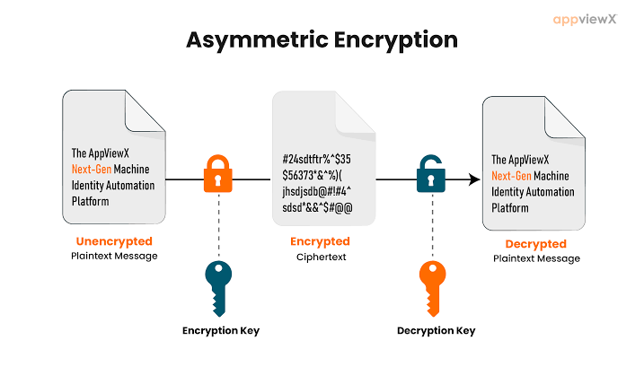

Slide 10
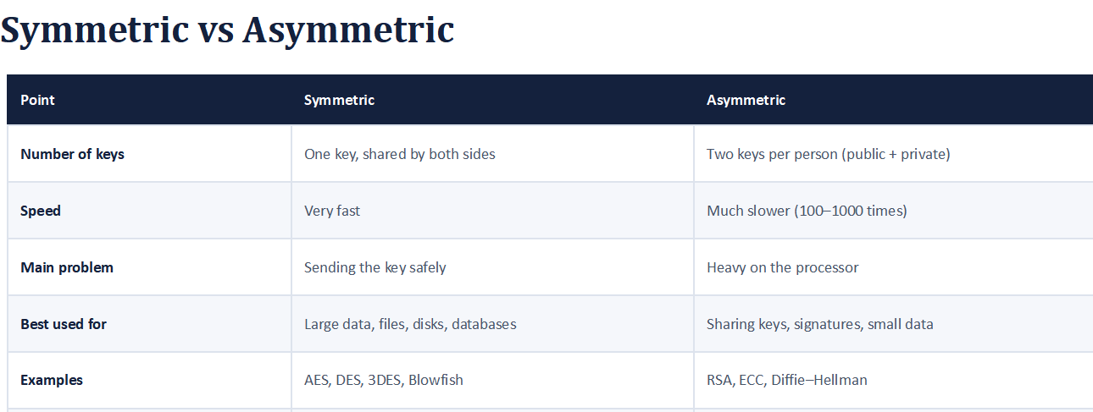

Slide 11
Hash Functions
Definition
A hash function is a mathematical algorithm that takes input data and produces a hash value.
For example:
Input: "Hello"
↓
Hash Function
↓
Output: 2cf24dba5fb0a30e..

Slide 12
Just as every person's fingerprint can help identify a person, a hash can help identify whether data is the same or has changed.
Hashing is designed to be one-way.
A small change in the input usually produces a very different hash.
Hello → Hash A
hello → Hash B
Hash A ≠ Hash B
Applications of Hash Functions
Password Storage:
Hash functions provide protection to password storage. Instead of storing passwords in clear, mostly all login processes store the hash values of passwords in the file.
he password file is a table of pairs in the format (user id, h(P)).
Data Integrity Check:
Data integrity checks, commonly using hash functions, provide assurances about the accuracy of data files by creating checksums. This method allows users to detect any alterations made to the original file

Slide 13
Digital Signaturre
Definition :
A digital signature is an electronic, encrypted stamp of authentication on digital information such as messages. The digital signature confirms the integrity of the message.
Example:
Suppose Ali wants to send an important PDF document to Sara.
Ali creates the document.
Ali uses his private key to create a digital signature for the document.
He sends the document + digital signature to Sara.
Sara uses Ali’s public key to verify the signature.
If the signature is valid, Sara knows:
The document really came from Ali (authentication).
The document was not changed after Ali signed it (integrity).

Slide 14
Features
1. Authentication: Digital signature verifies the identity of the sender. It confirms that the message came from a trusted source.
2. Integrity: It ensures that the message or document has not been changed or tampered with after it was digitally signed.
3. Non-repudiation: The sender cannot later deny sending the message or signing the document because the digital signature uniquely belongs to them.
4. Legal Validity: In India, digital signatures are legally accepted and have the same value as physical signatures under IT laws.
5. Security: Digital signatures use encryption technology, which makes them highly secure and reliable for online transactions.

